Slide 1
3D Face Model for Surgical Simulation and Visualization
2024/04/23
Presenter: Yu-Sheng Tzou 鄒雨笙
E-mail: daniel.tzou1021@gmail.com
Mobile: 0928592241
Advisor: PhD Chiou-Shann Fuh 傅楸善博士

Slide 2
Outline
Introduction
Methods
Result
Summary

Slide 3
Introduction

Slide 4
A-TOP Health BIOTECH CO., LTD
捷立康生物科技股份有限公司創立於 2021 年，公司位在內湖科技園區
目前正在研發拉皮線，與模擬拉皮效果的軟體技術

Slide 5
VECTRA 3D

Slide 6
VECTRA 3D
2 systems
Capture System
Vectra H2 3D
Vectra M3 3D
Vectra XT 3D
Software System
Face Sculptor®
Breast Sculptor®
Body Sculptor®

Slide 7
Capture System: Vectra H2 3D
DSLR: Digital Single Lens Reflex Camera
DEMO: https://www.youtube.com/watch?v=hoZzH34nXoA
Capture system specifications
Capture Volume
Face capture: 320mm (H) x 180mm (W) x 200mm (D)
Body capture: 700mm (H) x 410mm (W) x 400mm (D)
2.0 milliseconds capture time
Stereo photogrammetry technology
3D Resolution (triangle edge length)
Face capture: 1.2mm
Body capture: 3.5mm
Multiple image stitching capability
On-board modular, intelligent flash unit
Dual Ranging lights for easy patient positioning (Face and Body)
Face + Body 3D Imaging System

Slide 8
Capture System: Vectra H2 3D
DSLR: Digital Single Lens Reflex Camera
DEMO: https://www.youtube.com/watch?v=hoZzH34nXoA
Software:
VECTRA Capture Module
VECTRA Analysis Module
Mirror® PhotoFile®
Mirror® PhotoTools
Face Sculptor® (optional)
Skin Analysis Sculptor (optional)
Breast Sculptor® (optional)
Body Sculptor® (optional)
Face + Body 3D Imaging System

Slide 9
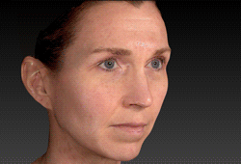
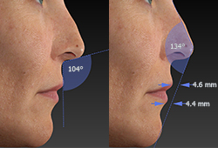
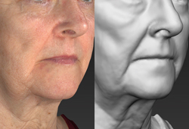
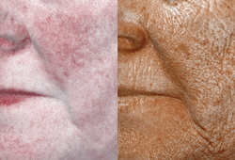
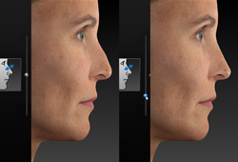
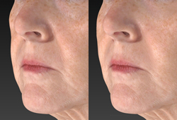
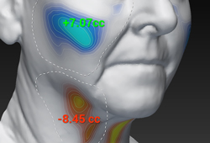
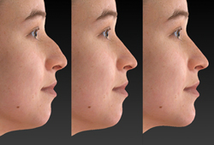
Software System: Face Sculptor®
3D skin analysis
Automated measurements
Gray mode
RBX® technology
Simulate realistic 3D results
Contouring
Volume difference
Complementary procedures

Slide 10
Crisalix

Slide 11
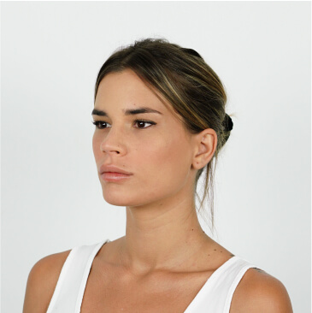
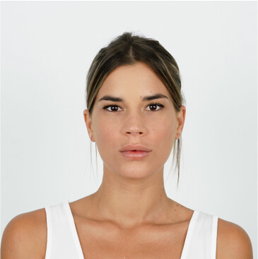
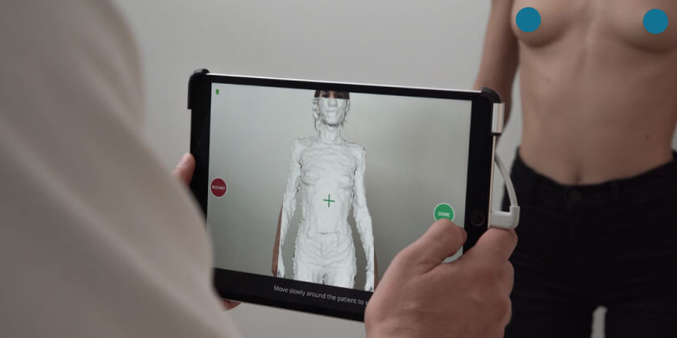
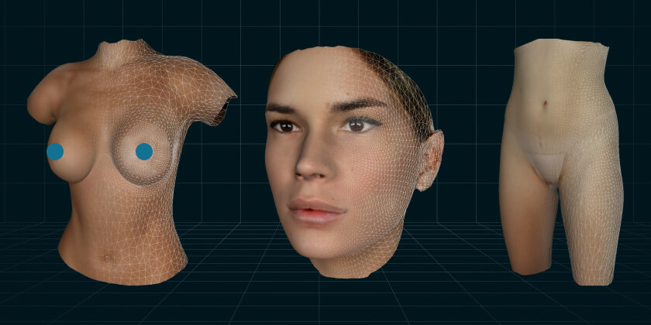
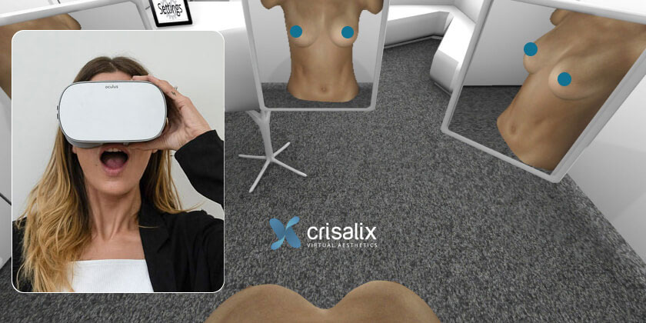
VR: Virtual Reality
AR: Augmented Reality
Crisalix
AI APP
3 Photos
3D Model
Clinic Consultation
Infrared Camera
3D Model
VR & AR

Slide 12
Crisalix
Face assessment
Automated measurements
Rhinoplasty
Face lifting
Eyebrows & Foxy eyes
Blepharoplasty
Cheek & neck treatments
Dermal fillers & toxin
Lip augmentation
Chin & jawline augmentation
Face tightening
Bichectomy
Laser procedures
Breast assessment
Automated measurements
Breast augmentation
Breast reduction
Mastopexy / Breast lift
Implants Revision
Fat transfer
Breast implants
IMF positioning
Breast cleavage
Scars
Breast reconstruction
5D dynamics
Virtual clothes
Body assessment
Automated measurements
Abdominoplasty / Tummy tuck
Liposuction / Liposculpture
Body contouring
Buttocks
Lipo High Definition

Slide 13
Requirements of A-TOP Health
3D skin analysis
Face lifting
Automated measurements
Complementary procedures

Slide 14
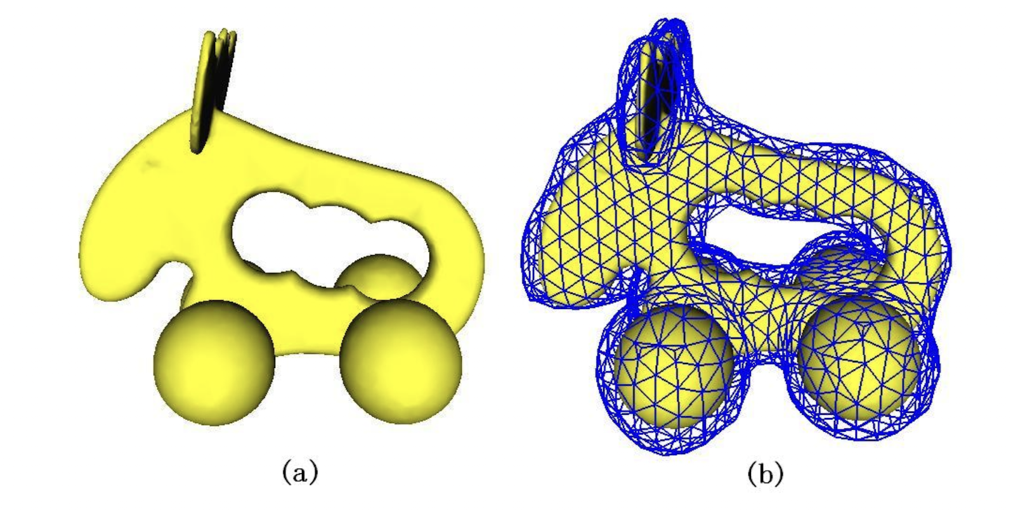
Methods: Coarse Bounding Cages Algorithm
Source: Xian, C., Lin, H., & Gao, S. (2009, June). Automatic generation of coarse bounding cages from dense meshes. In 2009 IEEE International Conference on Shape Modeling and Applications (pp. 21-27). IEEE.

Slide 15
1. Preliminaries
CBC: Coarse Bounding Cages
Basic Concepts
Given a dense mesh model with connected mesh surface, the algorithm first voxelizes the mesh model, and then classifies the voxels into 3 types: feature, outer and inner voxels.
⇒ tri-values distance field
To measure the degree of sparseness of a CBC, we define the sparse factor, denoted by S_{F} :
where, N_{d} and N_{c} are the numbers of vertices of a dense mesh and its CBC, respectively.
Assign value 0, 1, -1
Source: Xian, C., Lin, H., & Gao, S. (2009, June). Automatic generation of coarse bounding cages from dense meshes. In 2009 IEEE International Conference on Shape Modeling and Applications (pp. 21-27). IEEE.
Notes:
We assign value 0 to the feature voxels, 1 to the outer voxels, and −1 to the inner voxels. They make up of the tri-values distance field.
1) Compute the bounding box of the dense mesh by Principal Component Analysis (PCA);
2) Voxelize the mesh model, identify feature voxels, and calculate the tri-value distance field;
3) Extract and triangulate the outer faces of the feature voxels;
4) Smooth the CBC by an improved mean curvature flow method.

Slide 16
1. Preliminaries
PCA: Principal Component Analysis
Overview of the Algorithm
Source: Xian, C., Lin, H., & Gao, S. (2009, June). Automatic generation of coarse bounding cages from dense meshes. In 2009 IEEE International Conference on Shape Modeling and Applications (pp. 21-27). IEEE.
Notes:
We assign value 0 to the feature voxels, 1 to the outer voxels, and −1 to the inner voxels. They make up of the tri-values distance field.
1) Compute the bounding box of the dense mesh by Principal Component Analysis (PCA);
2) Voxelize the mesh model, identify feature voxels, and calculate the tri-value distance field;
3) Extract and triangulate the outer faces of the feature voxels;
4) Smooth the CBC by an improved mean curvature flow method.

Slide 17
2. Coarse Bounding Cage Generation
SVD: Singular Value Decomposition
1) Bounding Box Computation by PCA
The (p, q, r)-th moment m_{pqr} of mesh M is given by,
In the discrete form, denoting the coordinates of vertices of mesh M by ${\text{\{}\text{x}\text{i}\text{, }\text{yi}\text{, }\text{zi}\text{\}}}_{i=1}^{N}$, its (p,q,r)-th moment can be approximated by
SVD to Covariance Matrix obtained from (3)
⇒ 3 characteristic direction vectors as the axes of a new Cartesian coordinate system
Source: Xian, C., Lin, H., & Gao, S. (2009, June). Automatic generation of coarse bounding cages from dense meshes. In 2009 IEEE International Conference on Shape Modeling and Applications (pp. 21-27). IEEE.
Notes:
網格 M 的矩的定義
By performing singular value decomposition to the covariance matrix, we get three characteristic direction vectors as the axes of a new Cartesian coordinate system with the origin at the centroid of mesh M.
The (�,�,�)(p,q,r)-th moment of a mesh �M is a measure of the distribution of the mesh's mass relative to the axes of a coordinate system. In your formula
Physical Analogy: If you think of the mesh as a physical object with density, the moments correspond to the balance points or centers of mass for various orientations. They give you an idea of where the mass is concentrated in relation to the coordinate system.

Slide 18
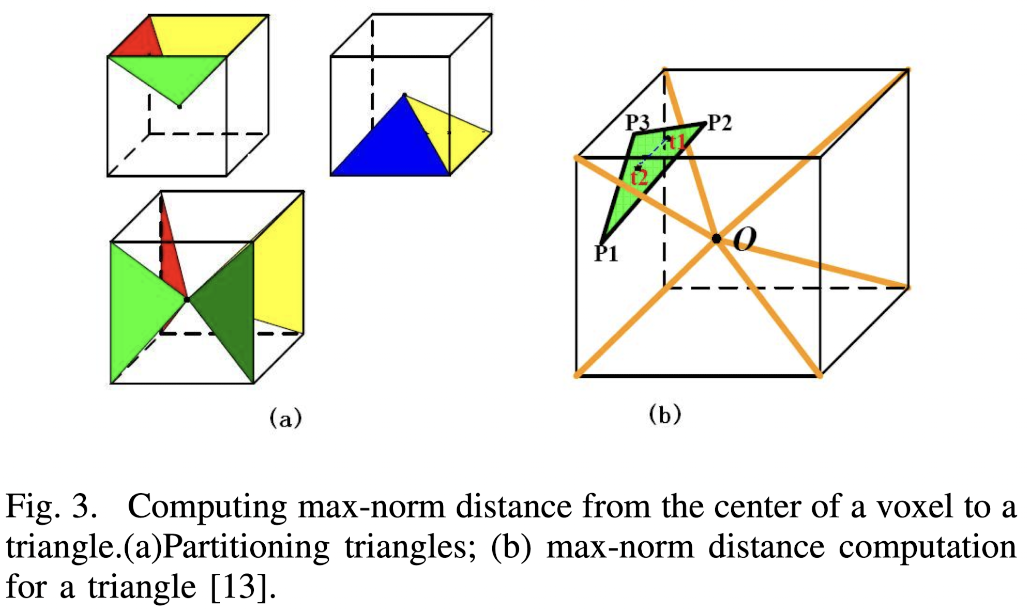
2. Coarse Bounding Cage Generation
2) Voxelization and Tri-value Distance Field Calculation
To identify feature voxels, we need to check which voxels the mesh M intersects with.
Max-norm Distance Computation Method:
Let w_{v}, d∞ be the length of an edge of a voxel and the max-norm distance from its center to a triangle of mesh M.
If d∞ ≤ $\frac{\text{w}}{2}$, the voxel intersects with the triangle
⇒ identified as a feature voxel, assigned value 0
Source: Xian, C., Lin, H., & Gao, S. (2009, June). Automatic generation of coarse bounding cages from dense meshes. In 2009 IEEE International Conference on Shape Modeling and Applications (pp. 21-27). IEEE.
Notes:
立體像素化
最大正交距離計算方法
In this step, the bounding box generated in section 3.1 is discretized into a series of voxels, feature voxels are identified, and the tri-value distance field is computed.

Slide 19
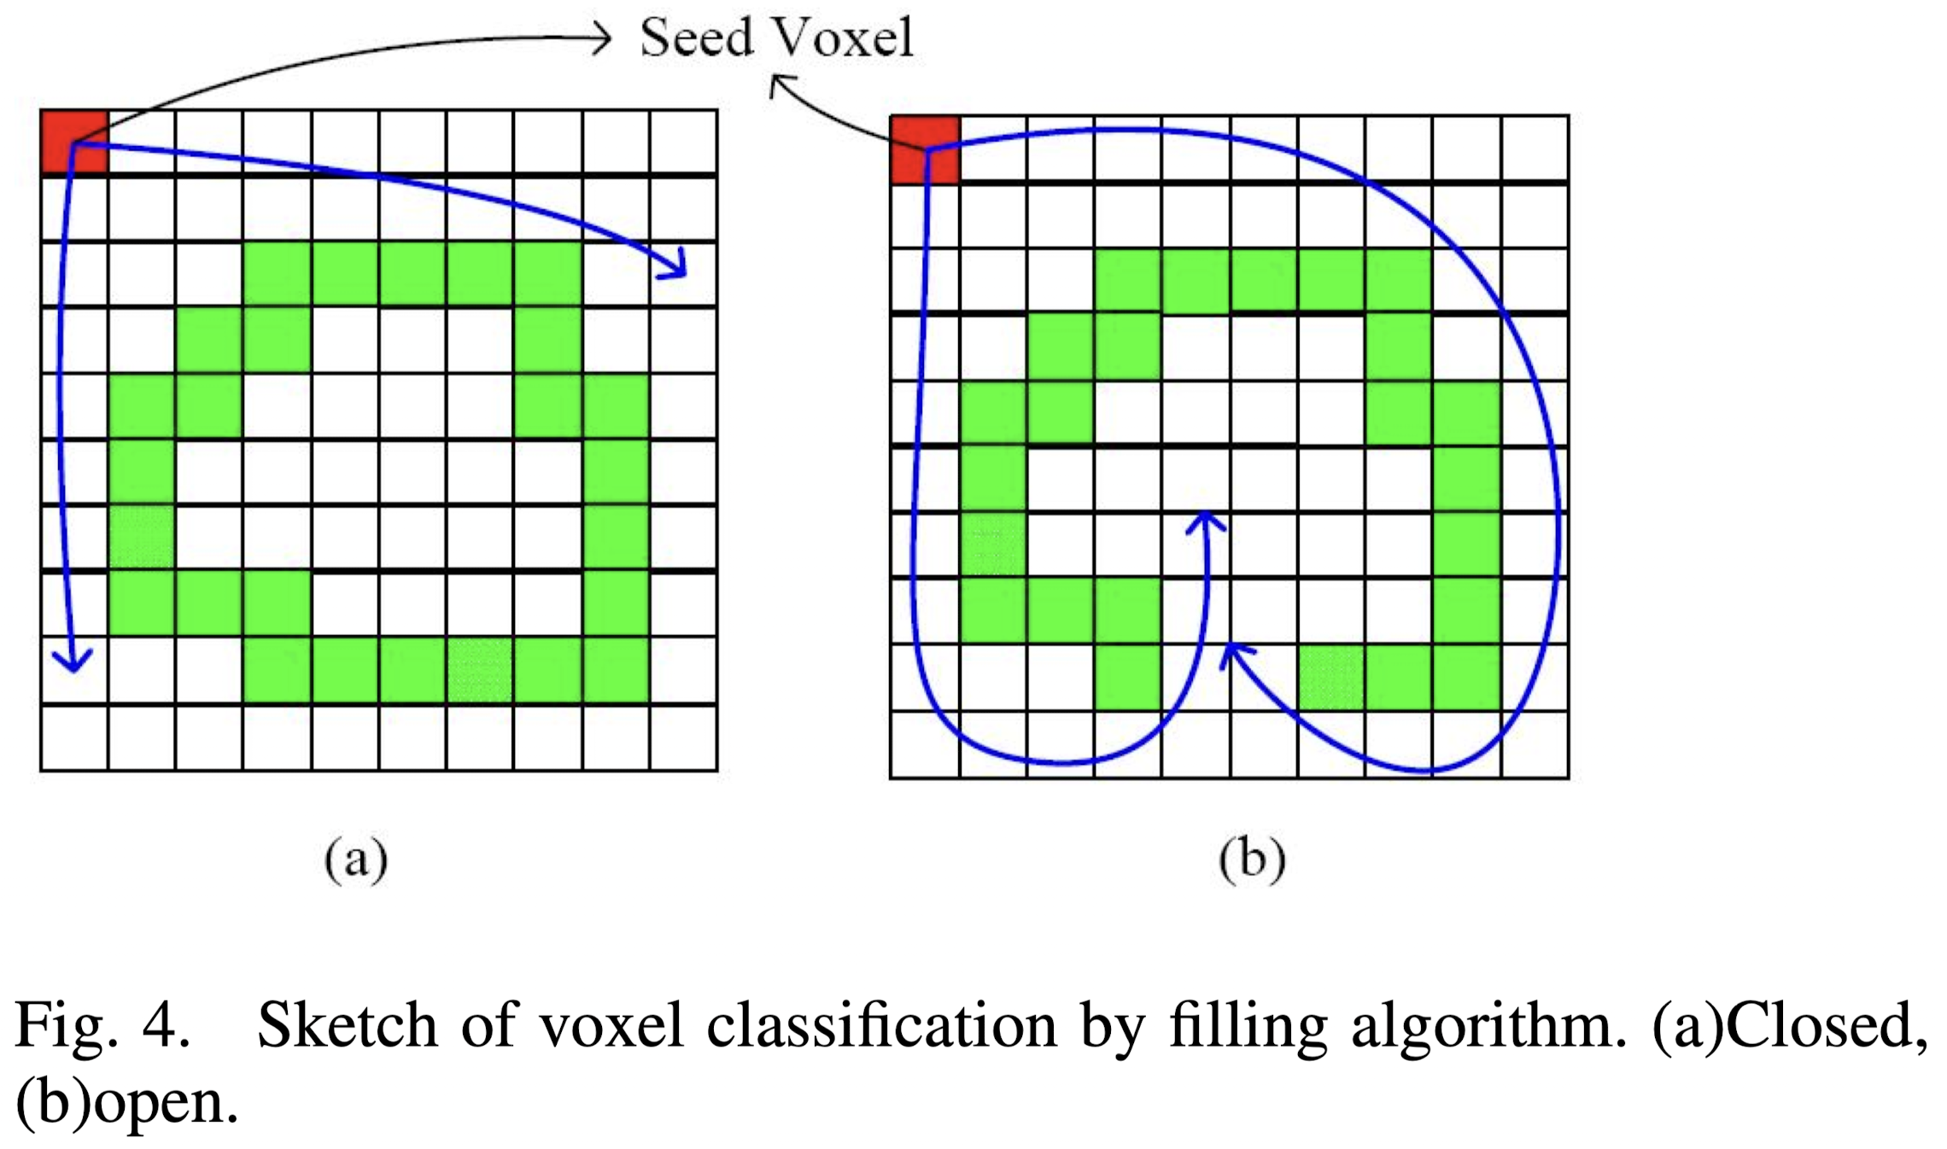
2. Coarse Bounding Cage Generation
2) Voxelization and Tri-value Distance Field Calculation
Filling Algorithm:
Source: Xian, C., Lin, H., & Gao, S. (2009, June). Automatic generation of coarse bounding cages from dense meshes. In 2009 IEEE International Conference on Shape Modeling and Applications (pp. 21-27). IEEE.
Notes:
The outer voxels are first distinguished by the filling algorithm starting from a seed. According to the construction of the bounding box, the eight corner voxels are certainly outer voxels, and can be taken as the seed. All outer voxels are assigned value 1.

Slide 20
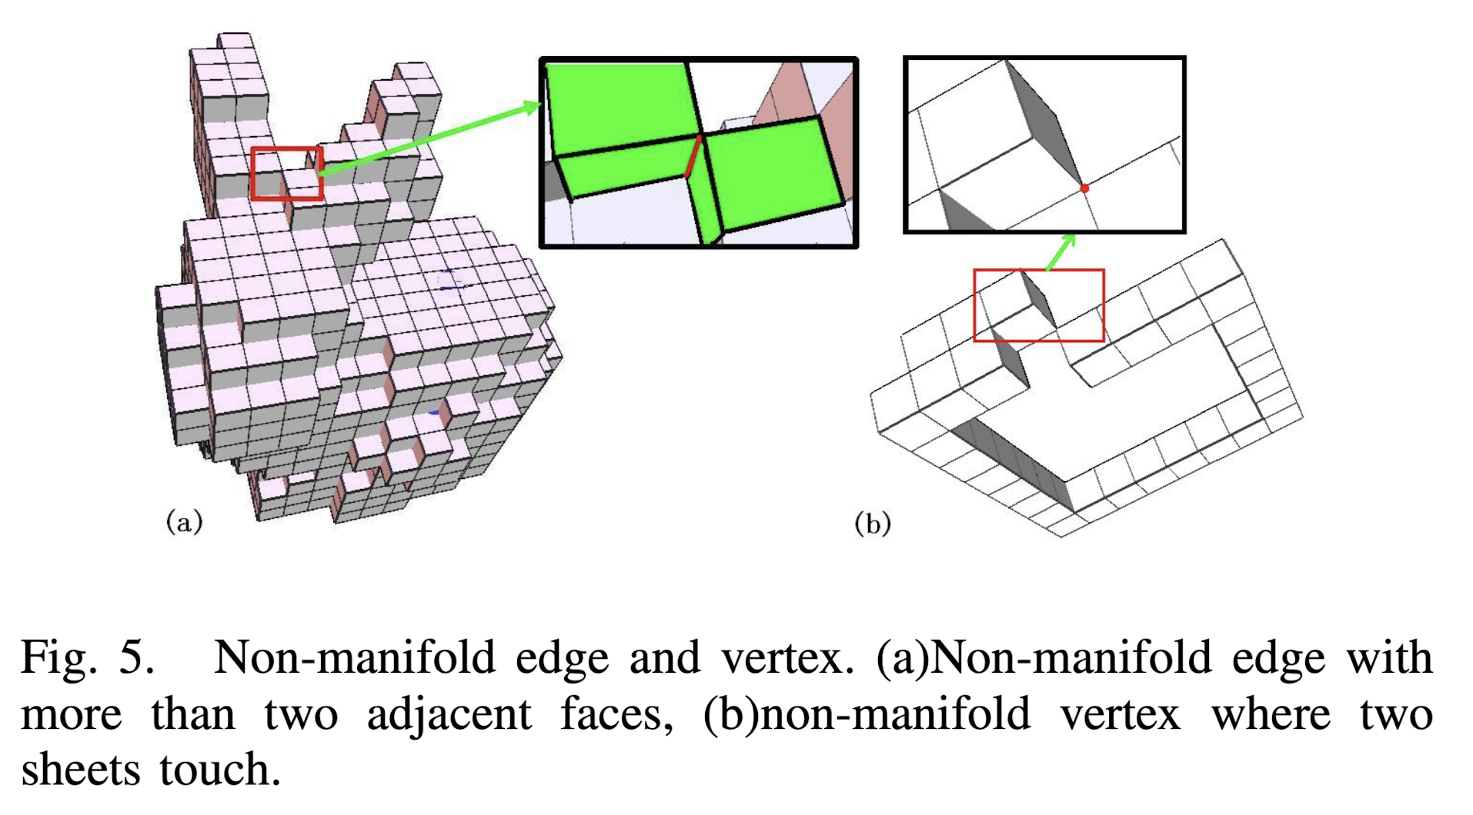
2. Coarse Bounding Cage Generation
3) Outer Surface Extraction and Triangulation
By checking the values of adjacent voxels for each face of each feature voxel, the outer surface of the feature voxel set can be generated, which constitutes the initial CBC
Source: Xian, C., Lin, H., & Gao, S. (2009, June). Automatic generation of coarse bounding cages from dense meshes. In 2009 IEEE International Conference on Shape Modeling and Applications (pp. 21-27). IEEE.
Notes:
立體像素化
最大正交距離計算方法
In this step, the bounding box generated in section 3.1 is discretized into a series of voxels, feature voxels are identified, and the tri-value distance field is computed.

Slide 21
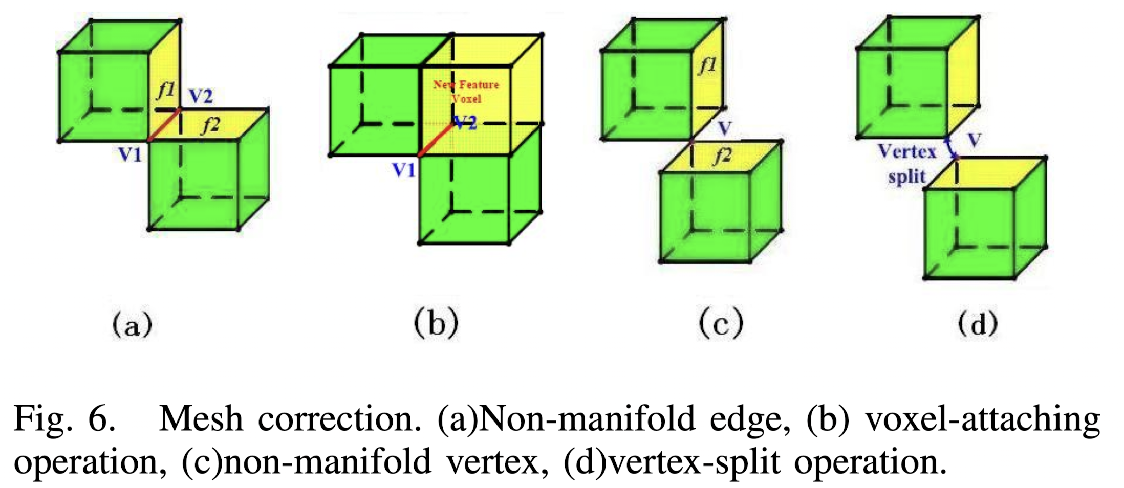
2. Coarse Bounding Cage Generation
3) Outer Surface Extraction and Triangulation
The voxel-attaching and vertex-split operations make a non-manifold CBC be a valid 2-manifold mesh.
Source: Xian, C., Lin, H., & Gao, S. (2009, June). Automatic generation of coarse bounding cages from dense meshes. In 2009 IEEE International Conference on Shape Modeling and Applications (pp. 21-27). IEEE.

Slide 22
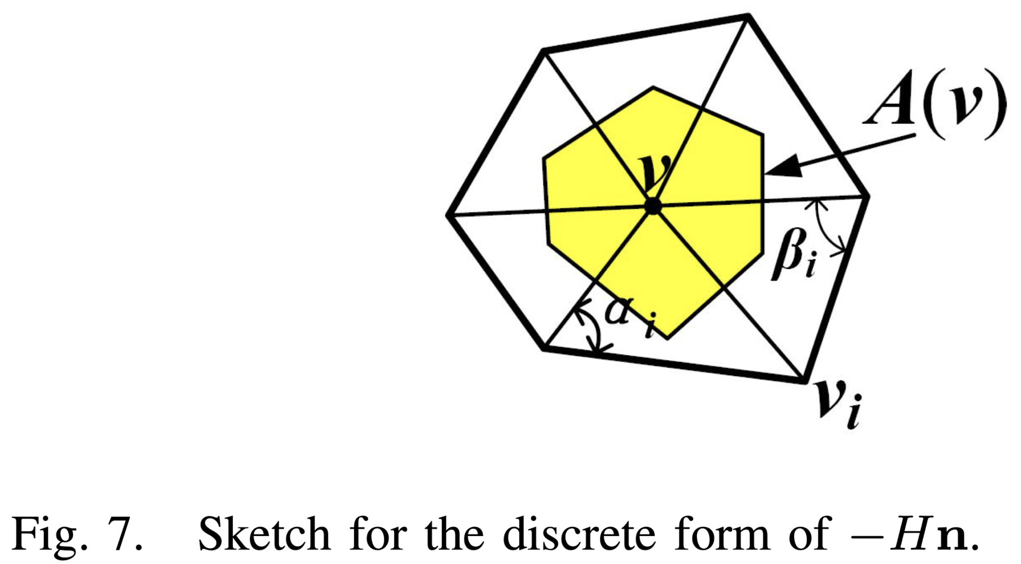
2. Coarse Bounding Cage Generation
4) Cage Smoothing
Mean Curvature Flow method
The method performs iteratively by,
where, ${vi}^{0}$ are the vertices of the initial CBC, H is the mean curvature, and n is the unit normal vector. μdt is the time step satisfying 0 ≤ μdt ≤ 1
Source: Xian, C., Lin, H., & Gao, S. (2009, June). Automatic generation of coarse bounding cages from dense meshes. In 2009 IEEE International Conference on Shape Modeling and Applications (pp. 21-27). IEEE.
Notes:
the mean curvature flow method [15] is improved to smooth the CBC while guaranteeing that it always encloses the mesh M during smoothing
Positive vs. Negative Values: Positive cotangent weights suggest an angle less than 90 degrees between mesh elements, commonly associated with convex features. Negative weights indicate concave features. This distinction helps algorithms adaptively modify mesh regions based on their geometric characteristics.

Slide 23
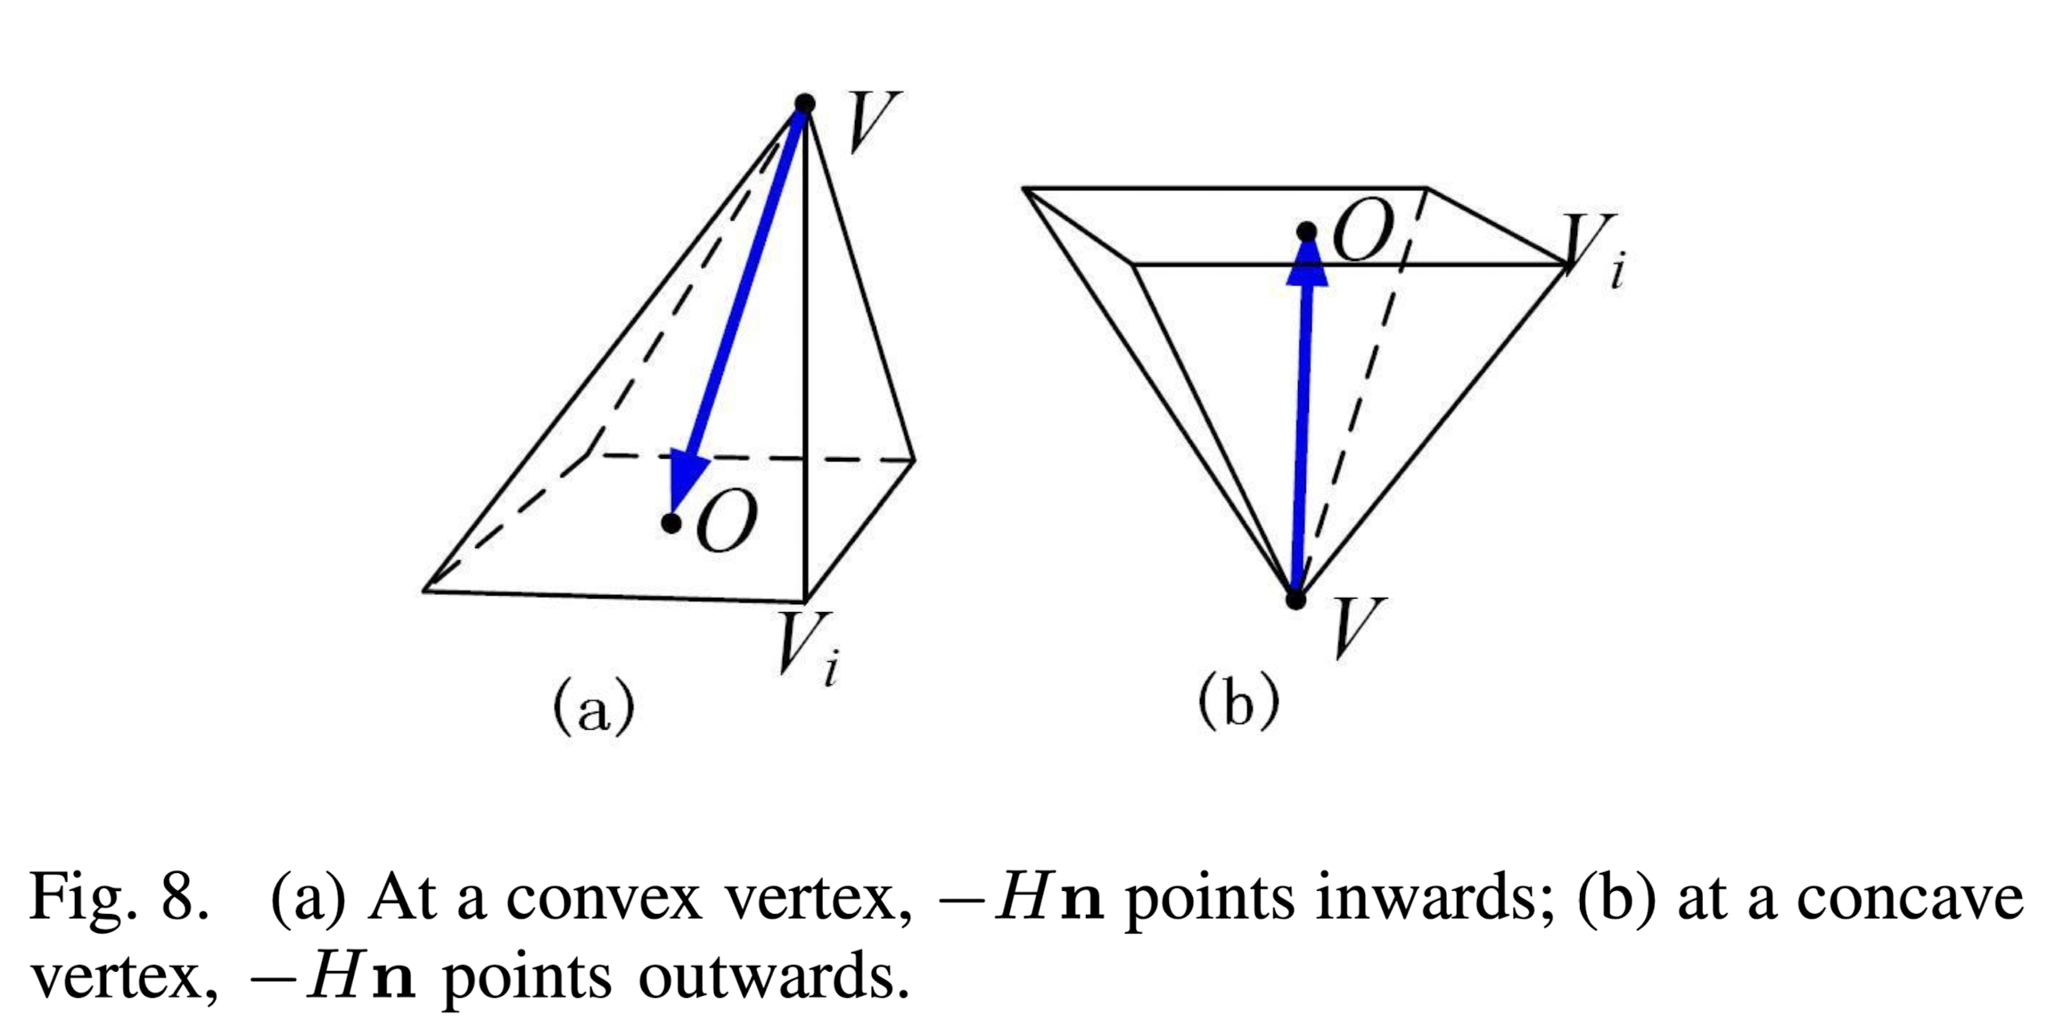
2. Coarse Bounding Cage Generation
4) Cage Smoothing
Mean Curvature Flow method (cont.)
The discrete form of −Hn can be computed by
where N(v) is the set of 1-ring neighbor vertices around v, A(v) denotes the Voronoi area around v, and α_{i}, β_{i} are two angles opposite to edge (v, v_{i})
weight
Source: Xian, C., Lin, H., & Gao, S. (2009, June). Automatic generation of coarse bounding cages from dense meshes. In 2009 IEEE International Conference on Shape Modeling and Applications (pp. 21-27). IEEE.
Notes:
the mean curvature flow method [15] is improved to smooth the CBC while guaranteeing that it always encloses the mesh M during smoothing
Positive vs. Negative Values: Positive cotangent weights suggest an angle less than 90 degrees between mesh elements, commonly associated with convex features. Negative weights indicate concave features. This distinction helps algorithms adaptively modify mesh regions based on their geometric characteristics.

Slide 24
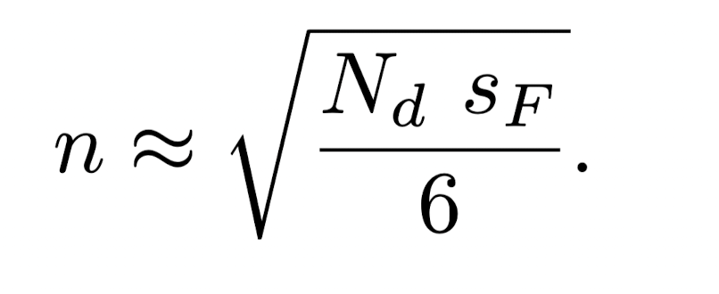
2. Coarse Bounding Cage Generation
5) Initial Resolution
Suppose n is the initial resolution, that is, the bounding box is discretized into n × n × n voxels. Then, on the six outer faces of the discretized bounding box, there are totally
${6(n+1)}^{2}+12n−\text{4}{\text{≈} 6n}^{2}$ vertices
where N_{d} is the number of vertices of the dense mesh M.
Initial resolution n
⇒
Source: Xian, C., Lin, H., & Gao, S. (2009, June). Automatic generation of coarse bounding cages from dense meshes. In 2009 IEEE International Conference on Shape Modeling and Applications (pp. 21-27). IEEE.

Slide 25
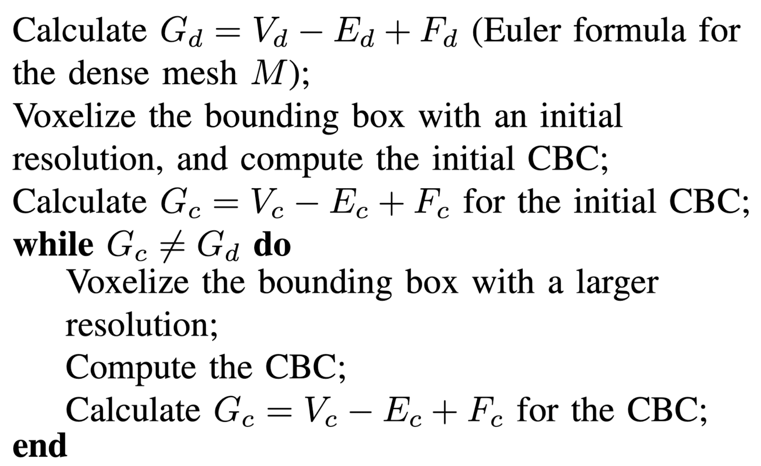
2. Coarse Bounding Cage Generation
6) Homeomorphic CBC Generation
By increasing the resolution of voxelization, if we can get a CBC whose value of Euler formula, G_{c} = V_{c} − E_{c} + F_{c}, is equal to that of the dense mesh M, G_{d} = V_{d} − E_{d} + F_{d}, they are homeomorphic to each other.
Source: Xian, C., Lin, H., & Gao, S. (2009, June). Automatic generation of coarse bounding cages from dense meshes. In 2009 IEEE International Conference on Shape Modeling and Applications (pp. 21-27). IEEE.
Notes:
Here, Vc , Ec , and Fc are the numbers of vertices, edges, and faces of the CBC, respectively; similarly, Vd,Ed, and Fd are the numbers of vertices, edges, and faces of the dense mesh M, respectively.
Homeomorphism refers to a topological property where two shapes (or spaces) are considered equivalent if they can be transformed into each other through continuous deformation (stretching, compressing, but not tearing or gluing). Essentially, if two objects are homeomorphic, they have the same "shape" in a topological sense, even if they look different geometrically.
Euler Characteristic
The Euler characteristic (�G) is a fundamental property in topology that remains invariant under homeomorphisms. For a polyhedral object (like a mesh), it's given by the formula:
�=�−�+�G=V−E+F
where �V is the number of vertices, �E is the number of edges, and �F is the number of faces in the mesh. This characteristic is a measure of the object's topological complexity.

Slide 26
Result

Slide 27
Result

Slide 28
Summary

Slide 29
Summary - Test
Method: Coarse Bounding Cage Generation
Steps:
Bounding Box Computed by PCA
Voxelization
Outer face extraction
Optimization
Results:
Deform the 3D face model in real-time

Slide 30
Thanks for Listening!

